Slide 1
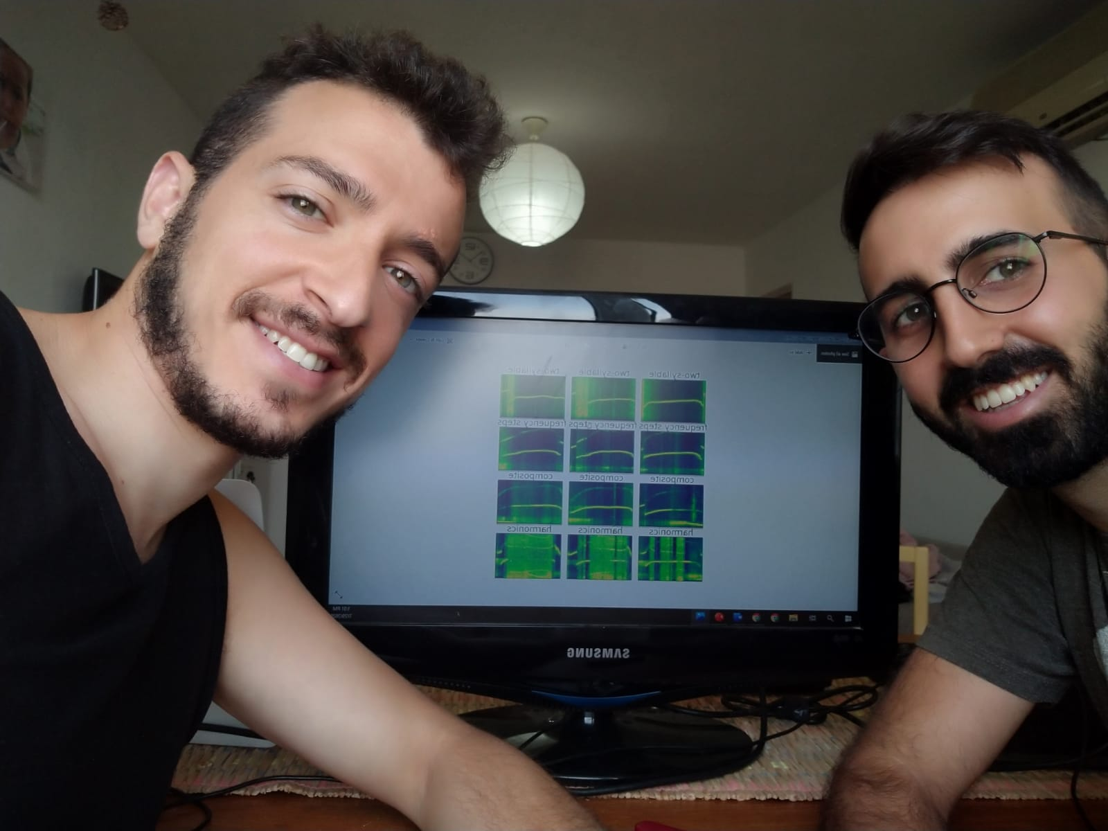
Identification and classification of ultrasonic vocalizations in mice using Deep Neural Networks in order to predict autistic behavior
Omri Malbin
Yaniv Rotaru
Supervisors:
Prof Hava Golan
Dr Dror Lederman

Slide 2
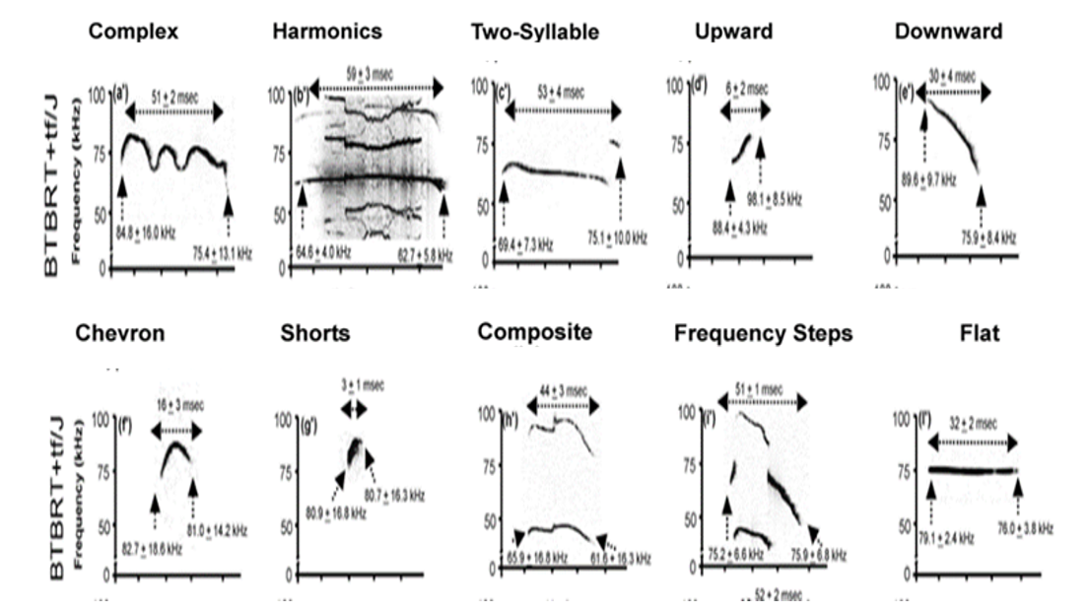
Background
ASD – Autism Spectrum Disorder
USV – Ultrasonic Vocalizations (mice)
70,000 USV recordings
10 main Labeled syllables – 5891

Slide 3
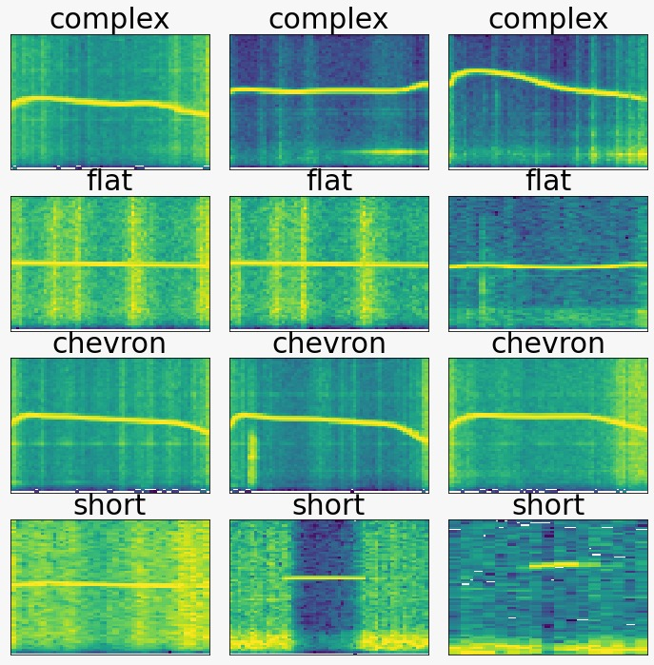
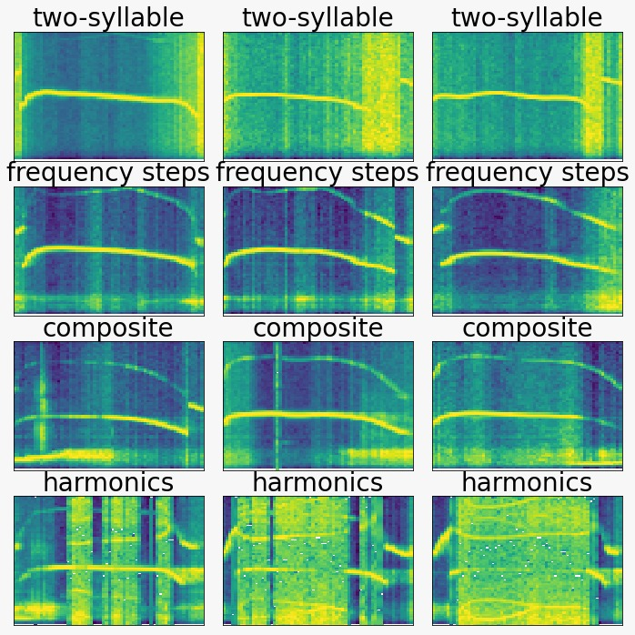
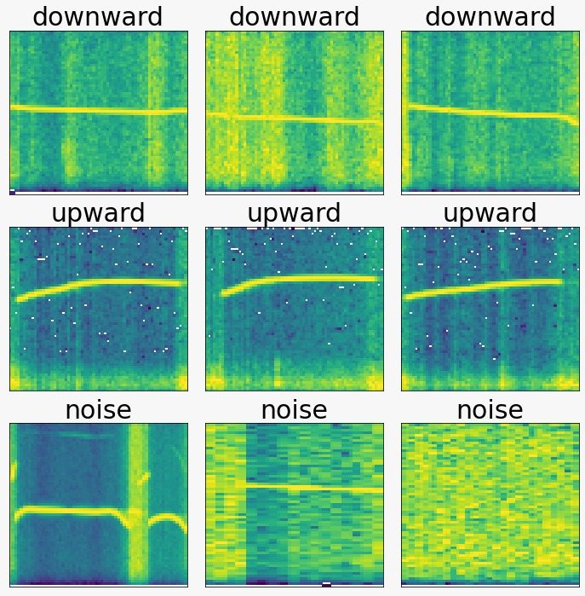
Spectrograms – our data
frequency steps | chevron | complex | composite | noise | two-syllable | upward | flat | harmonics | short | downward | Lables
1462 | 860 | 805 | 644 | 613 | 467 | 394 | 239 | 161 | 156 | 90 | Counts

Slide 4
Goals
Main goal – diagnosing autism at early stage of infancy.
Developing new classification algorithm for mice syllables.
Analyzing the statistical differences between syllables – Autism vs Non-Autism in order to deduct on autistic-like behavior in mice models.

Slide 5
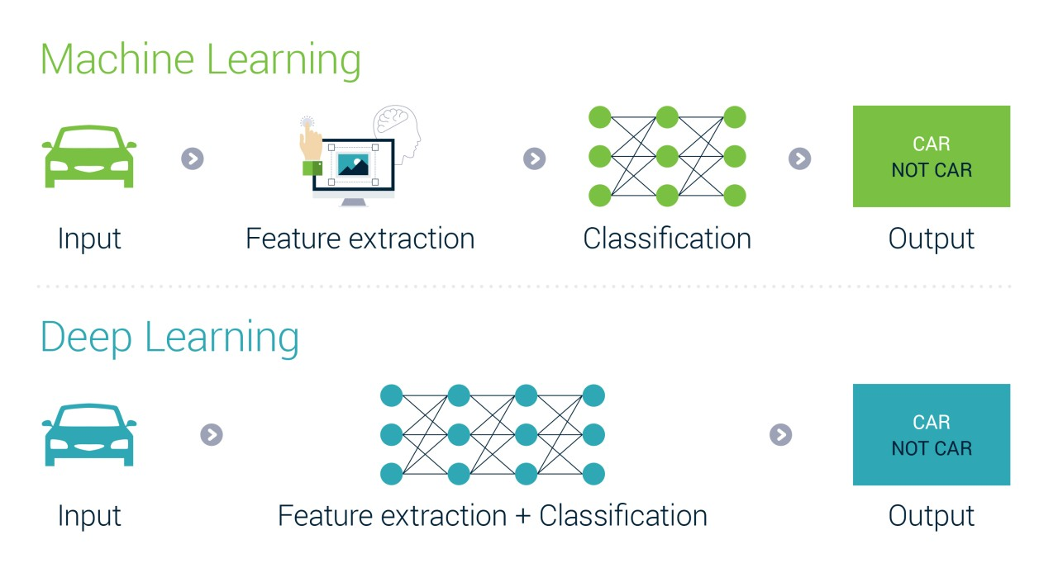
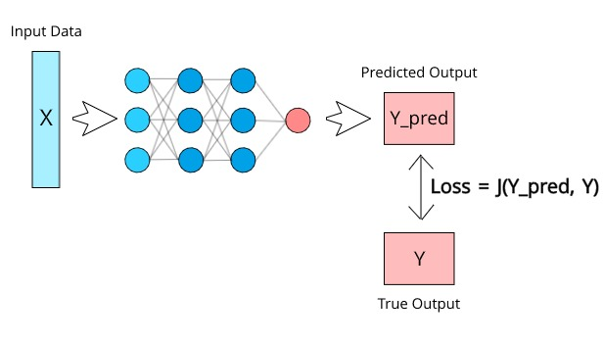
Methods
Machine learning vs deep learning
Unsupervised vs supervised learning

Slide 6
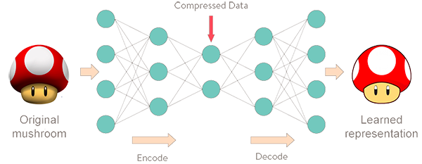
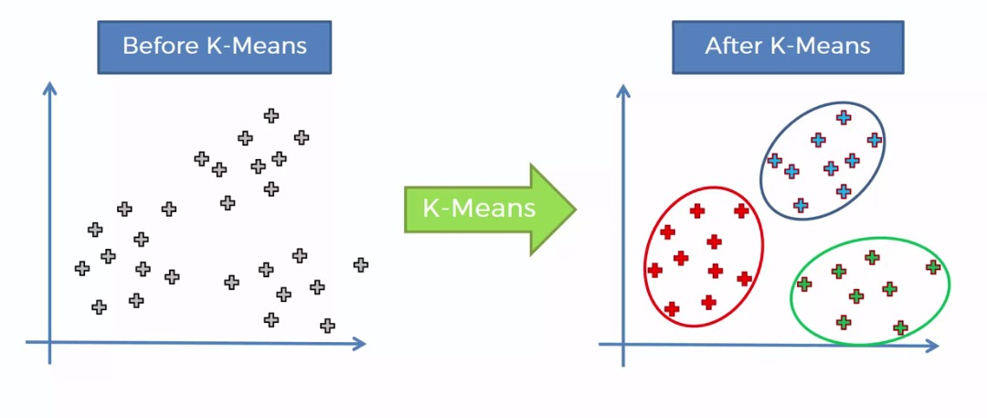
Clustering using autoencoders

Slide 7
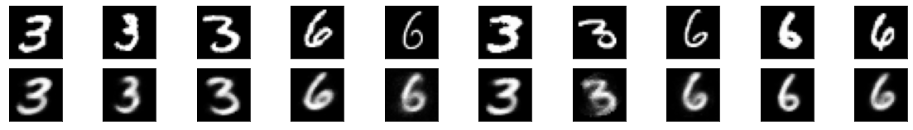
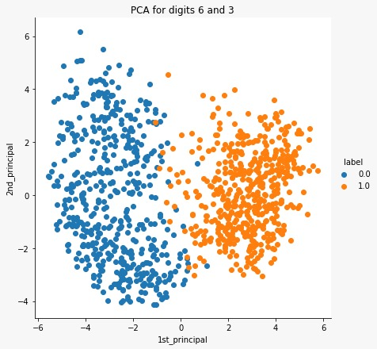
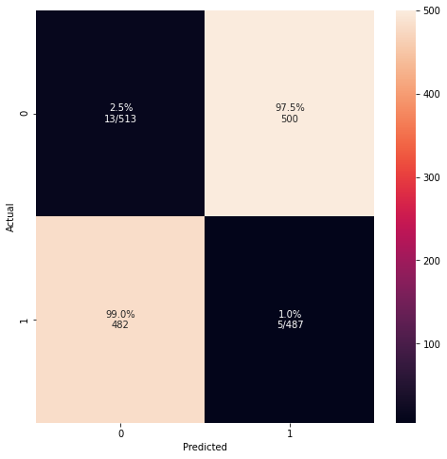
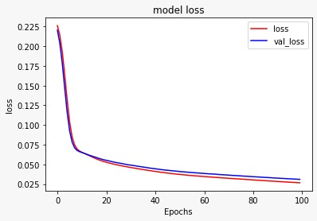
Results – Autoencoder (MNIST)
Original:
Reconstructed:

Slide 8
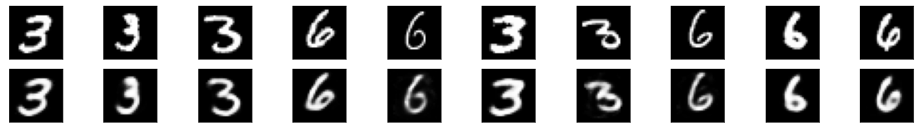
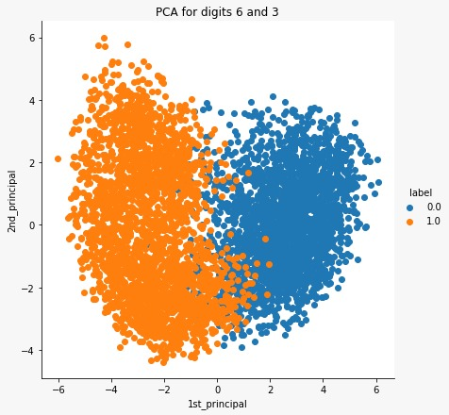
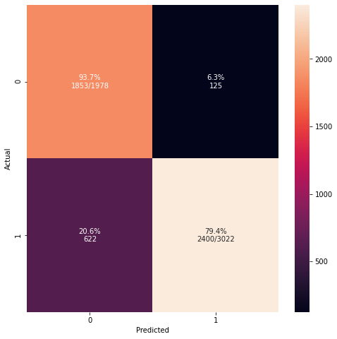
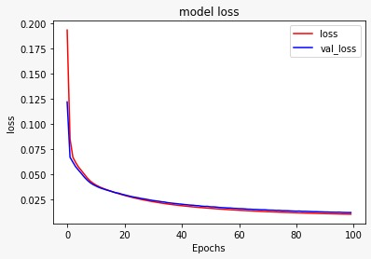
Results – Autoencoder (MNIST)
Augmentations
Original:
Reconstructed:

Slide 9
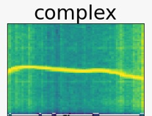
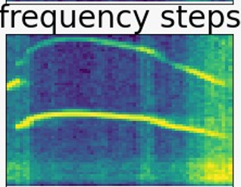
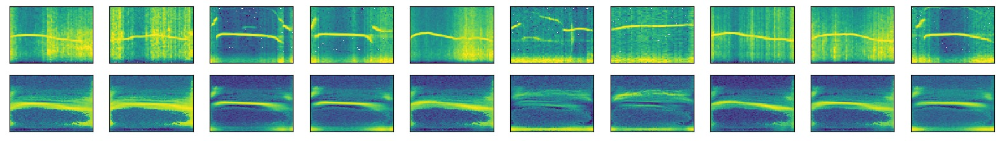
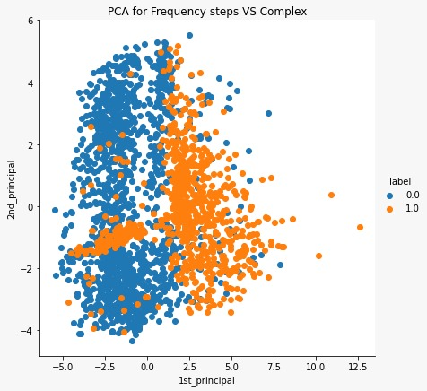
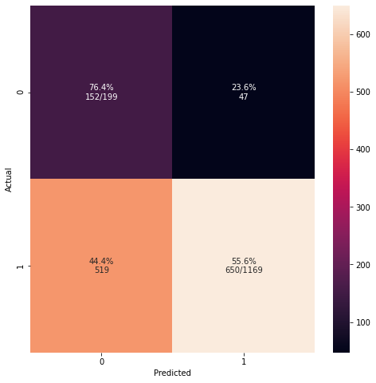
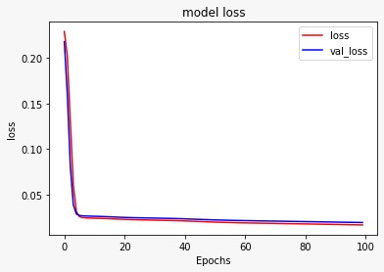
Results – Autoencoder (our data)
Original:
Reconstructed:

Slide 10
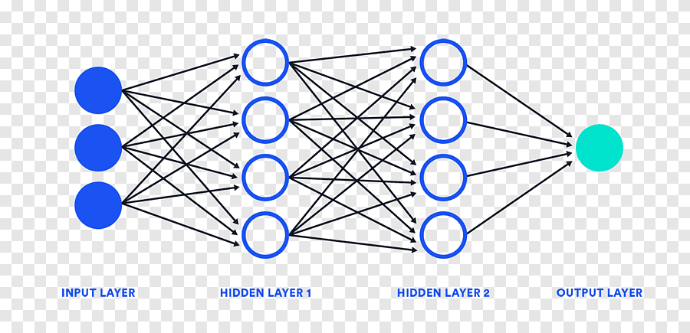
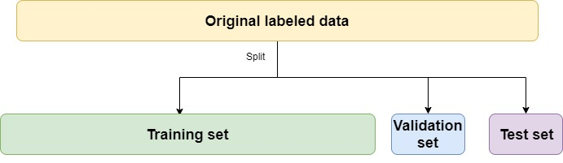
Classification using CNN
Convolutional Neural Network

Slide 11
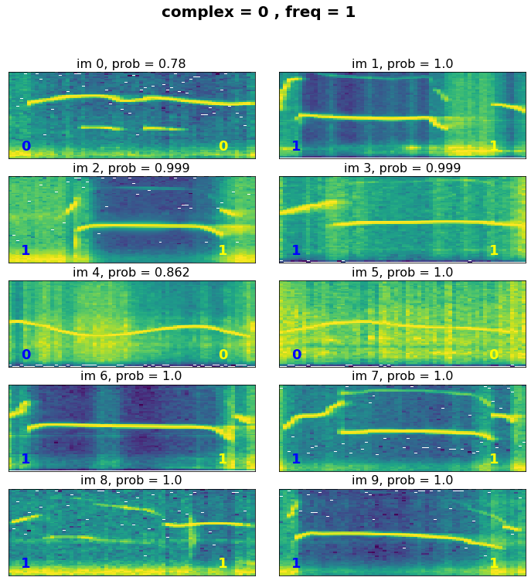
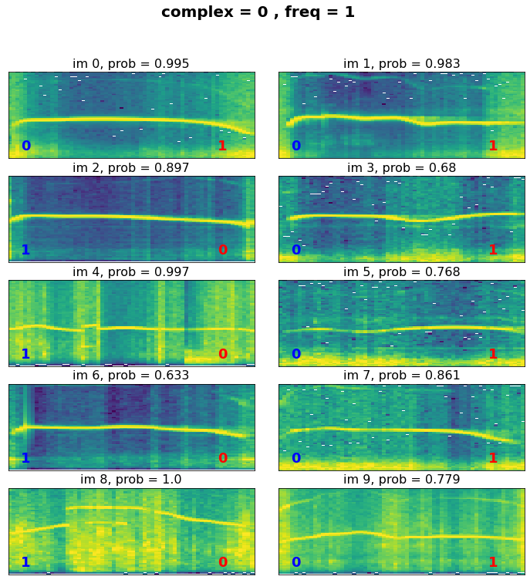
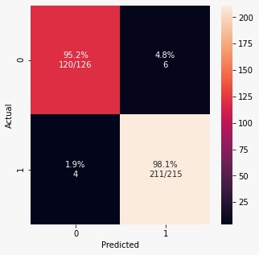
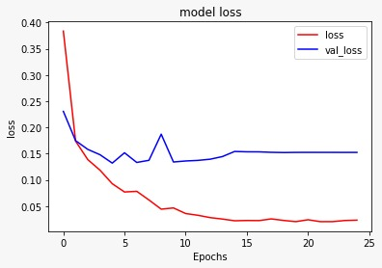
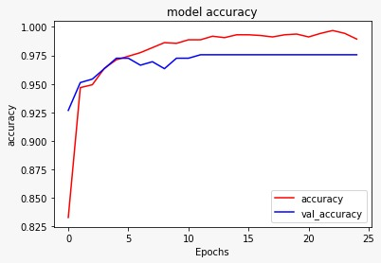
Results – CNN
Model Prediction
Model Errors
2 syllables – frequency steps vs complex
bottom left is true label and bottom right is model prediction

Slide 12
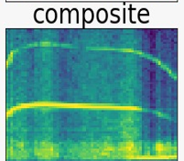
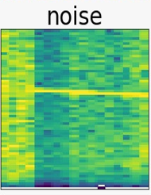
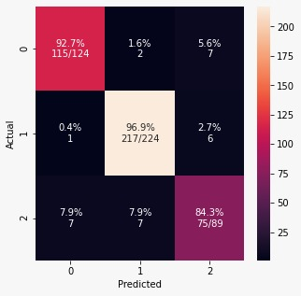
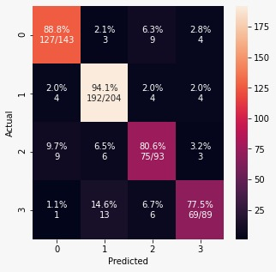
Results – CNN
3 syllables
4 syllables
Complex & Frequency Steps & Composite
Complex & Frequency Steps & Composite & noise

Slide 13
Conclusions
There is still work to do.
Increasing the amount of labeled data
Supervised learning
Another option is to consider other architectures; work with the signal and not with the spectrogram.

Slide 14
References
[1] S. E. Bryson, S. J. Rogers, and E. Fombonne, “Autism Spectrum Disorders: Early Detection, Intervention, Education, and Psychopharmacological Management,” Canadian Journal of Psychiatry. 2003.
[2] M. Wöhr and R. K. W. Schwarting, “Affective communication in rodents : ultrasonic vocalizations as a tool for research on emotion and motivation,” pp. 81–97, 2013.
[3] M. L. Scattoni, S. U. Gandhy, L. Ricceri, and J. N. Crawley, “Unusual Repertoire of Vocalizations in the BTBR T + tf / J Mouse Model of Autism,” vol. 3, no. 8, pp. 48–52, 2008.
[4] S. M. Mousavi, W. Zhu, W. Ellsworth and G. Beroza, "Unsupervised Clustering of Seismic Signals Using Deep Convolutional Autoencoders," in IEEE Geoscience and Remote Sensing Letters, vol. 16, no. 11, pp. 1693-1697, Nov. 2019
[5] R. Abbasi et al., “Applying convolutional neural networks to the analysis of mouse ultrasonic vocalizations,” in 23rd international congress on Acoustics, pp. 2925–2931, 2019.

